Slide 1

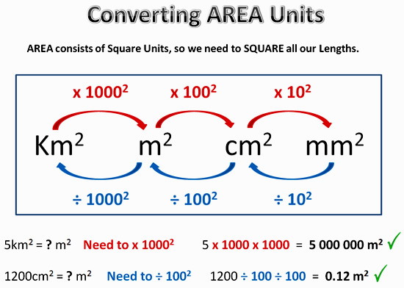
My Measurement Interactive Notebook
Name
Class
Teacher Ms Dhue
Term 1 Semester 1
1

Slide 2
Contents
Glossary or Formula Page
Page
Date
Description
2
3

Slide 3
Tasks
24
7
30
Essential Question
Questions
Notes
Summary
6
7

Slide 4
24
7
30
Date
Area Revision
EQ – How do you calculate the area of regular shapes
5
Notes:
Lesson objective (EQ)

Slide 5








Match-Up
Match the following formula’s with the correct shapes
$$b×h$$
$$\frac{θ}{360}πr^{2}$$
$$\frac{1}{2}\left(a+b\right)h$$
$$l^{2}$$
$$l×w$$
$$πr^{2}$$
$$\frac{1}{2}b×h$$
$$\frac{1}{2}a×b$$
Notes:
Students need worksheet ‘AreaFormula’ once completed students need to glue into note book

Slide 6
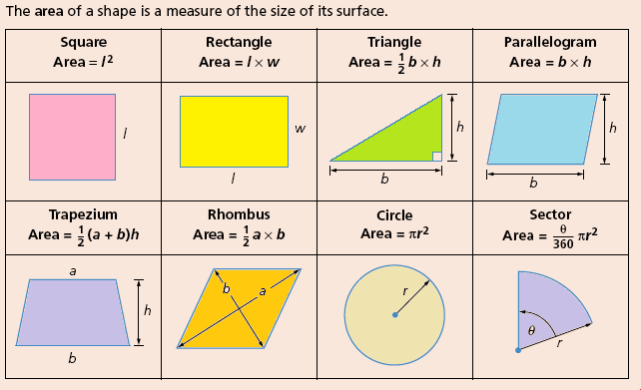
24
7
30
Date
Area Revision
EQ – How do you calculate the area of regular shapes
5
Notes:
Each click reveals the correct formula

Slide 7
Lesson objective
By the end of this lesson you will be able to;
- Calculate the area of a variety of shapes
Notes:
Lesson

Slide 8
Success Criteria
You will know you are successful in achieving the objective by…
Being able to calculate the area of a variety of shapes.

Slide 9
24
7
30
Date
Area Revision
EQ – How do you calculate the area of regular shapes
The process for calculating the area of a shape is
Identify the shape
Select the correct formula
Make sure the units are the same
Substitute the values into the formula
Calculate the area
Remember to include the units² in your answer
5
Notes:
Lesson objective (EQ)

Slide 10
24
7
30
Date
Area Revision
EQ – How do you calculate the area of regular shapes
Calculate the area of the following shape
12cm
Formula is Area = l x w
Substitute the values into the formula
Area = 12cm x 5cm
Area = 60cm ²
5cm
5
Notes:
Lesson objective (EQ)

Slide 11
24
7
30
Date
Area Revision
EQ – How do you calculate the area of regular shapes
Calculate the area of the following shape
12cm
Change 50mm to _______ cm
Formula is Area = l x w
Substitute the values into the formula
Area = 12cm x 5cm
Area = 60cm ²
50mm
Make sure the units are the same before calculating
5
Notes:
Lesson objective (EQ)

Slide 12
Shoulder Check
Check that the person next to you has all the notes written down.
Are they ready to move on?
Thumbs
Yes
No
Notes:
Check for understanding

Slide 13
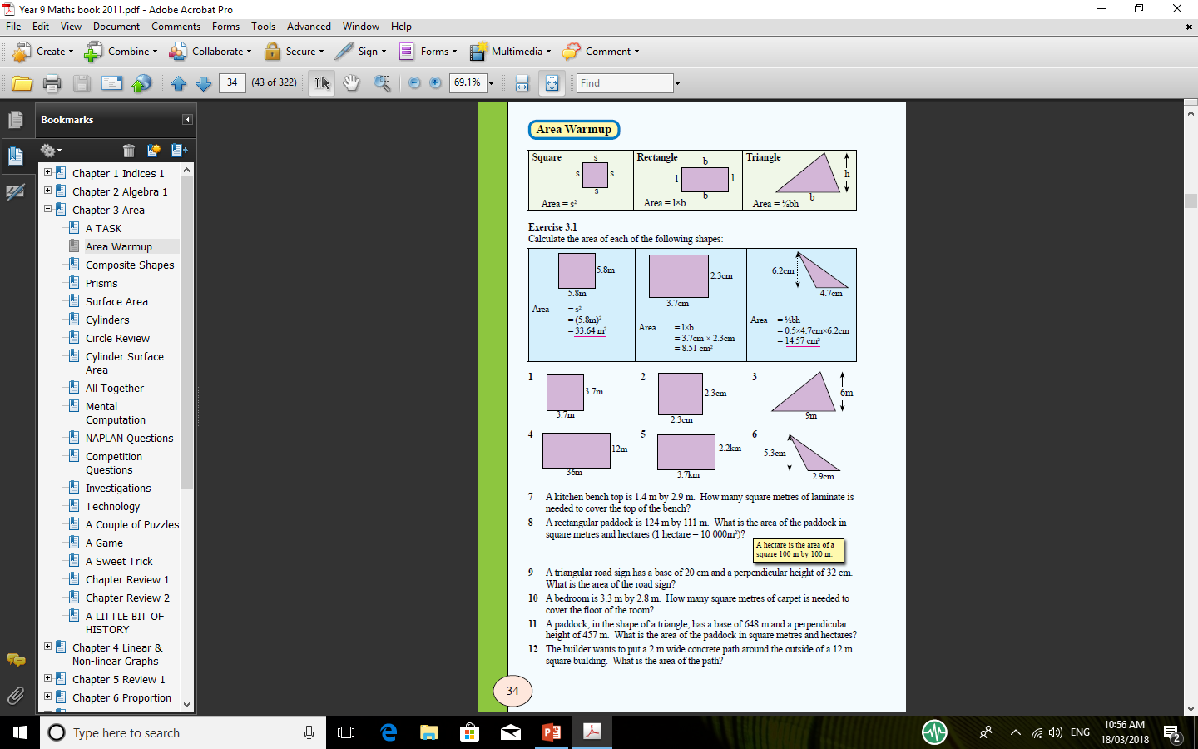
Activity
Then do questions 5, 6, 7 & 8 on both the front and back of the worksheet.
Notes:
Handout – ‘AreaReviewWorksheet’

Slide 14
24
7
30
Date
Area Revision
EQ – How do you calculate the area of composite shapes
The process for calculating the area of a shape is
Break the shape into regular shapes
Identify each shape
Select the correct formula’s
Calculate the dimensions of each shape
Make sure the units are the same
Substitute the values into the formula
Calculate the area of each shape
Combine the area’s (add or subtract)
Remember to include the units² in your answer
5
Notes:
Lesson objective (EQ)

Slide 15
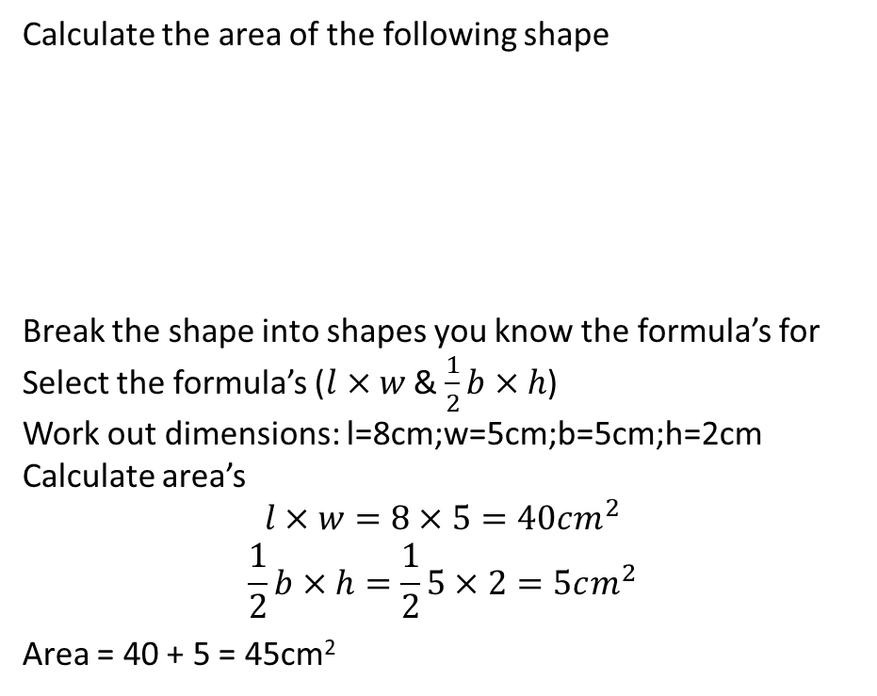
24
7
30
Date
Area Revision
EQ – How do you calculate the area of composite shapes
Calculate the area of the following shape
Break the shape into shapes you know the formula’s for
Select the formula’s ($l×w$& $\frac{1}{2}b×h$)
Work out dimensions: l=8cm;w=5cm;b=5cm;h=2cm
Calculate area’s
$$l×w=8×5=40cm^{2}$$
$$\frac{1}{2}b×h=\frac{1}{2}5×2=5cm^{2}$$
Area = 40 + 5 = 45cm²
10cm
5cm
8cm
5
Notes:
Lesson objective (EQ)

Slide 16
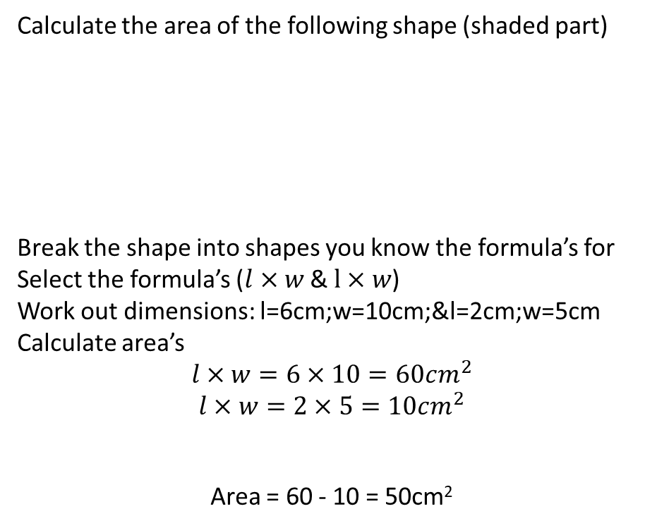
24
7
30
Date
Area Revision
EQ – How do you calculate the area of composite shapes
Calculate the area of the following shape (shaded part)
Break the shape into shapes you know the formula’s for
Select the formula’s ($l×w$& $l×w$)
Work out dimensions: l=6cm;w=10cm;&l=2cm;w=5cm
Calculate area’s
$$l×w=6×10=60cm^{2}$$
$$l×w=2×5=10cm^{2}$$
Area = 60 - 10 = 50cm²
6m
2m
5m
10m
5
Notes:
Lesson objective (EQ)

Slide 17
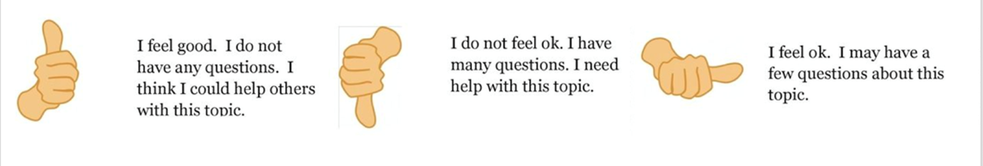
Check for understanding
Notes:
Check for understanding

Slide 18
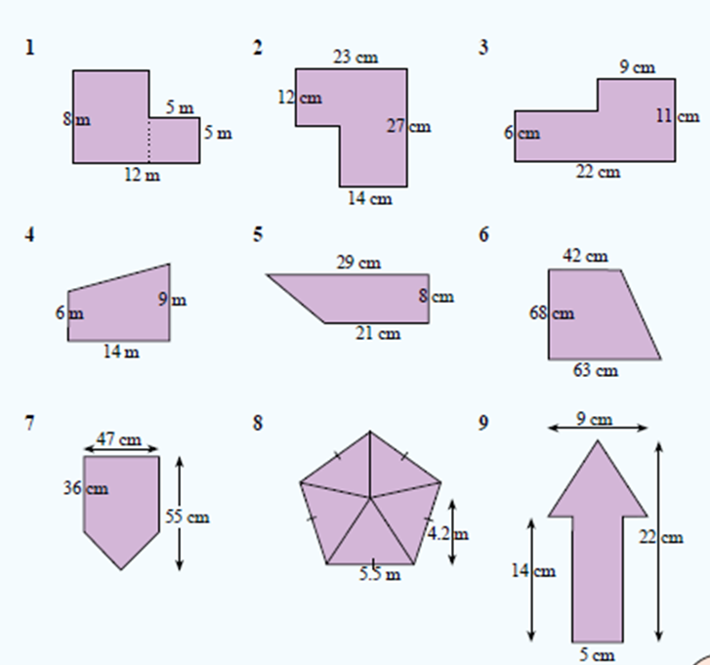
Activity
Notes:
Independent practice

Slide 19
Quick Write
Success Criteria
- Being able to calculate the area of a variety of shapes.
Jot down 3 points that demonstrate you have meet the “Success Criteria”
Notes:
Closure

